Slide 1
Binomial Nomenclature

Slide 2
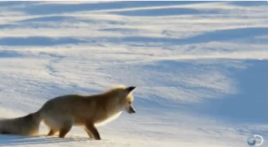
By the end of this lesson, you should be able to:
1. | Explain the binomial nomenclature and why it's used.
2. | Write scientific names correctly.
3. | List some examples of scientific names.

Slide 3
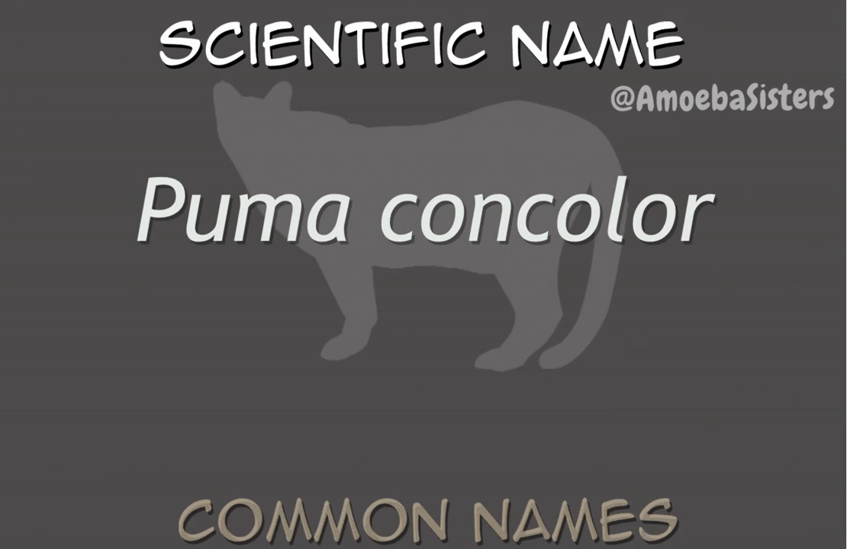
Binomial nomenclature is a set of rules we use to come up with scientific names.
It is needed so that all biologists, no matter what language they speak, can communicate about living things.

Slide 4


Slide 5
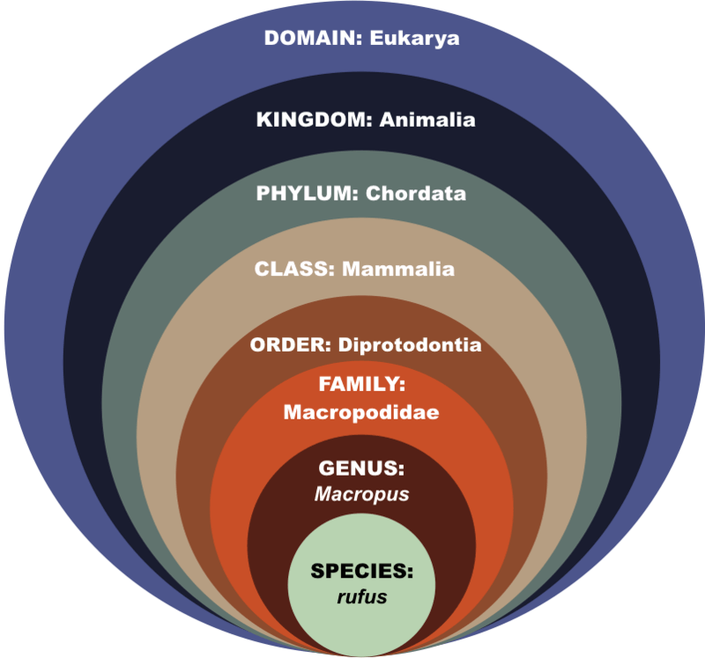
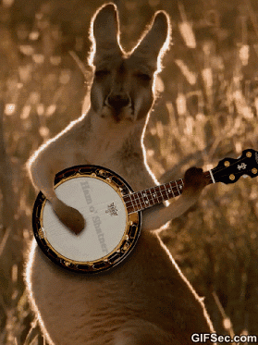
Every organism on Earth is classified using the binomial naming system.
They are classified into the levels you learned about in the previous lesson: Domain, Kingdom, Phylum, Class, Order, Family, Genus and Species.
Here is how a red kangaroo is classified!

Slide 6

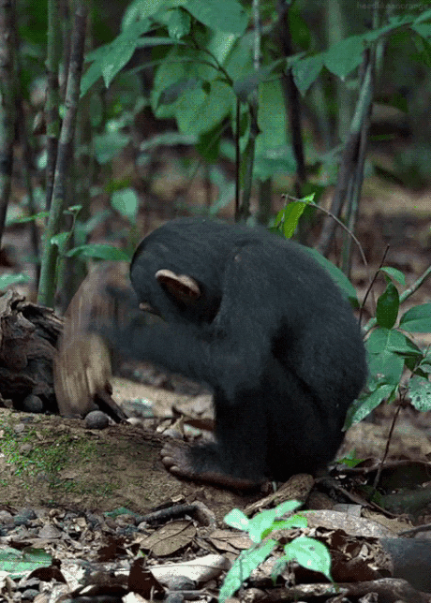
Another example is the chimpanzee, which is a closely related species to humans.
Here are the taxonomic levels of the common chimpanzee:

Slide 7
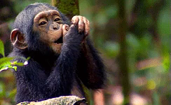

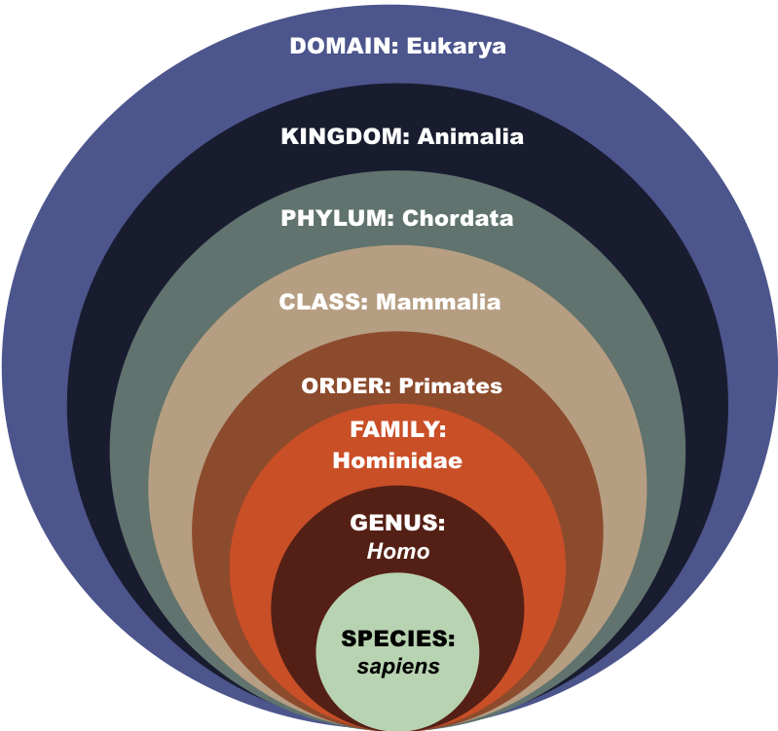
Now let's compare the classification of a chimpanzee and a human.
They only differ at the genus and species levels, which means we are very closely related to chimps!

Slide 8

There are some rules to write scientific names correctly.
The genus is always capitalized while the species name is written in lower case.
For example, the Great White shark is Carcharodon carcharias and the eucalyptus or blue gum is Eucalyptus globulus.

Slide 9

When you write a scientific name on a computer, you need to use italics.
When you write a scientific name by hand, you need to underline it.
On a computer: | Panthera tigris
In handwriting: | Panthera tigris

